Slide 1
The Yelp Elite
Who are they? And, do they matter?

Slide 2
Project Overview and Goals

Slide 3


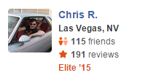
Should we pay attention to Elite Reviews?
Deciding between multiple restaurants all with four stars…
…leaves you relying on individual reviewers to make the final decision.

Slide 4
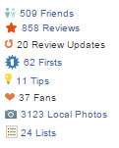
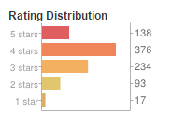

And, can we identify characteristics of people who aren’t yet labeled elite?
Rate a certain way?
Have a ton of fans?
Are considered funny?

Slide 5
Project Design and Processing

Slide 6

First, we will compare percent accuracy of elite vs. non-elite reviews in predicting overall ratings
Identify years that members were considered Elite
Identify individual reviews that came from members and then check if that member was elite
Full dataset that has each review for the business and whether or not that review came endorsed via an elite or non-elite Yelp member
Use logistic regression to determine the accuracy lift experienced by using elite reviews only

Slide 7

We will then use category prediction algorithms to help us to determine what predicts elite users
To contin

Slide 8
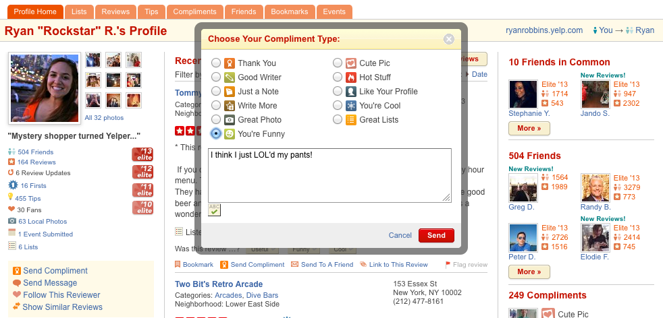
In specific, further parsing was done to understand if different types of user compliments matter

Slide 9
Central Findings

Slide 10
Elite reviews are more accurate in predicting total business success than non-elite reviews
Confusion Matrix I
Confusion Matrix II

Slide 11
Data Viz II: Cluster Results

Slide 12
Boston Elite Analysis

